Slide 1
Mapillary data exploration

Slide 2
Comparison model

Slide 3
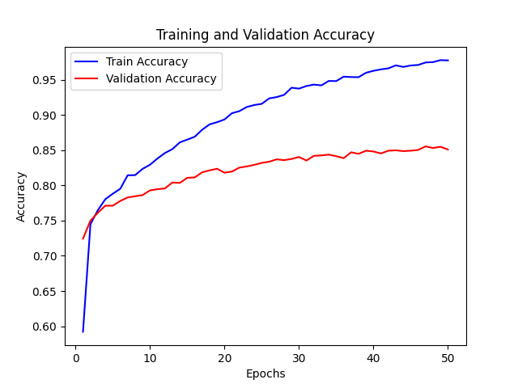
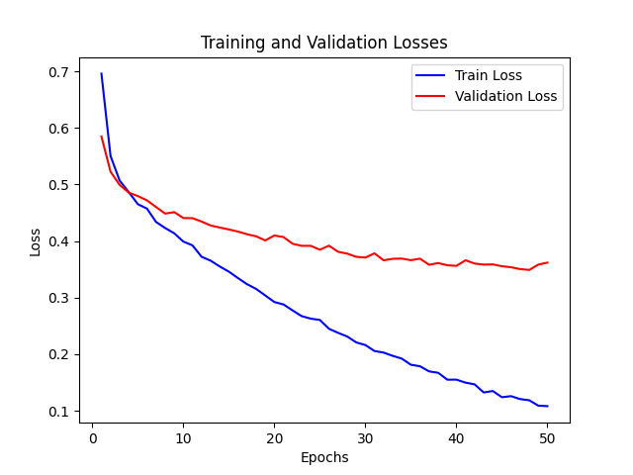
Comparison model given by fine tuning process

Slide 4
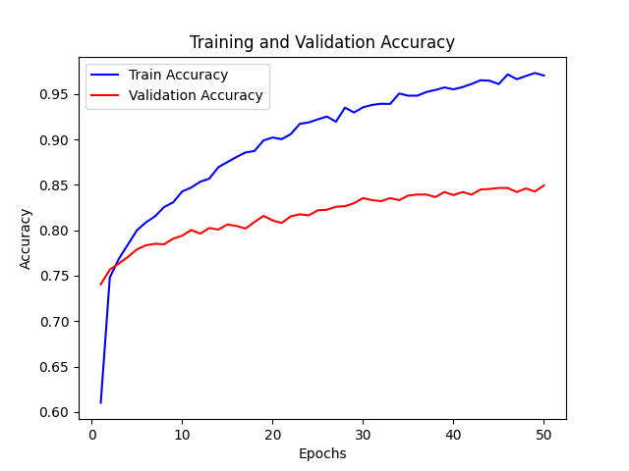
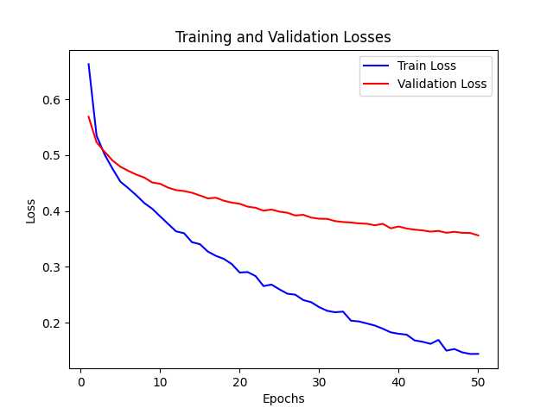
Comparison model handpicked from the fine tuning process

Slide 5
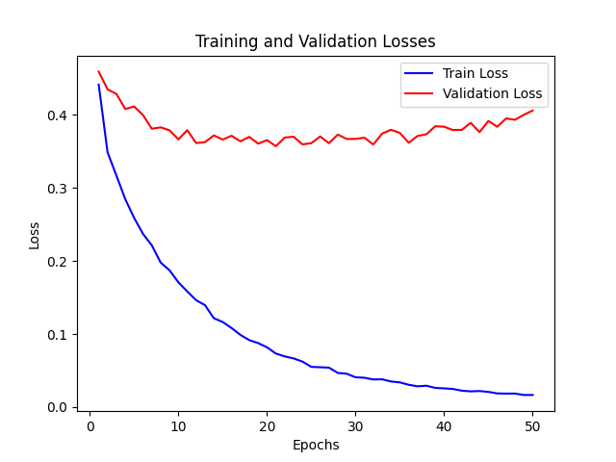
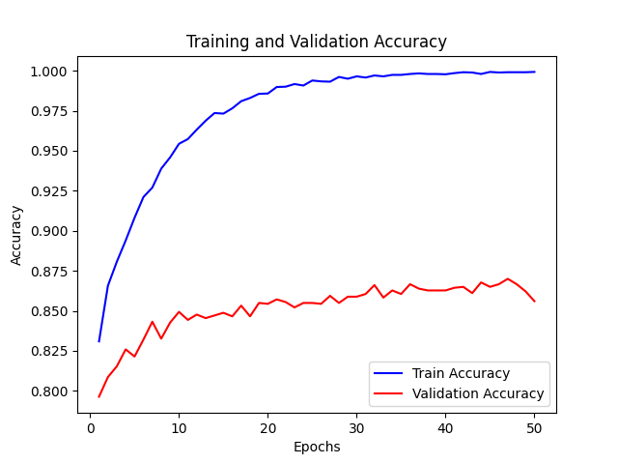
Comparison model using transfer learning with the model from Streetview

Slide 6
Ranking model

Slide 7
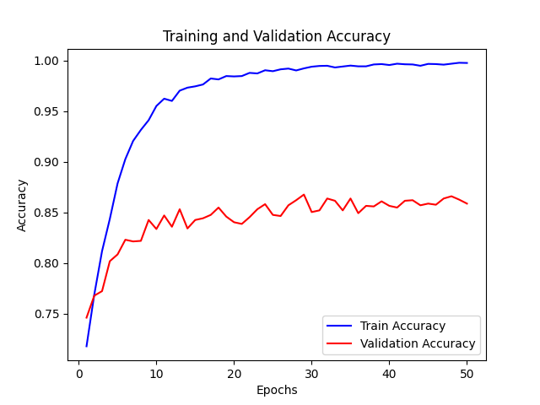
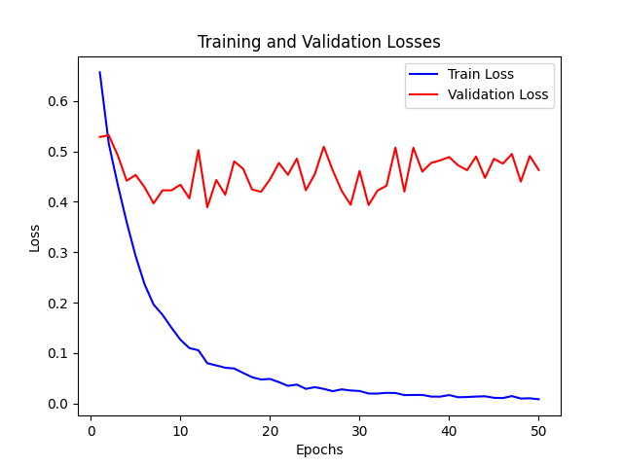
Ranking model given by the fine tuning process

Slide 8
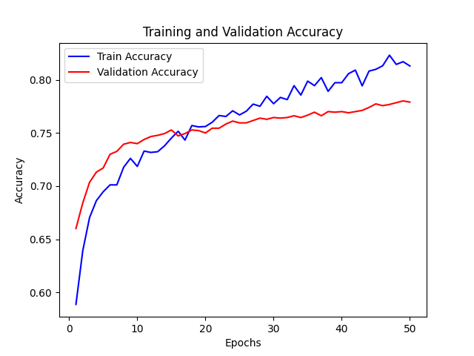
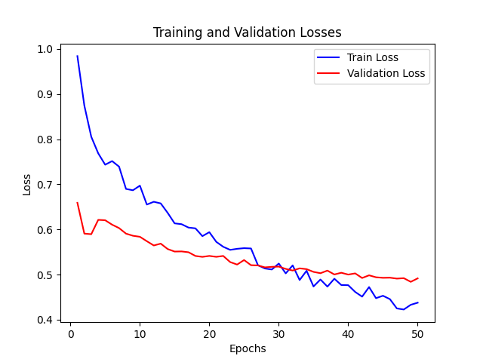
Ranking model that was handpicked from the tuning process

Slide 9
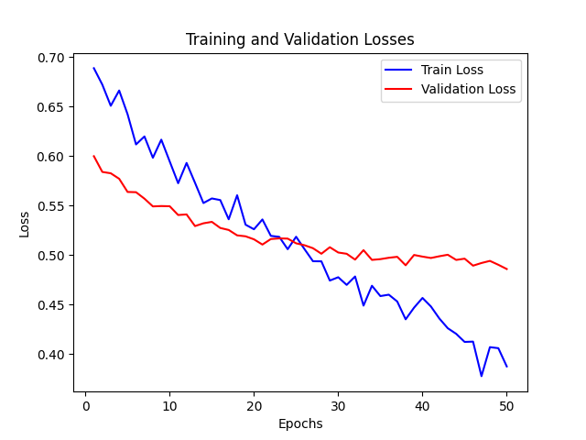
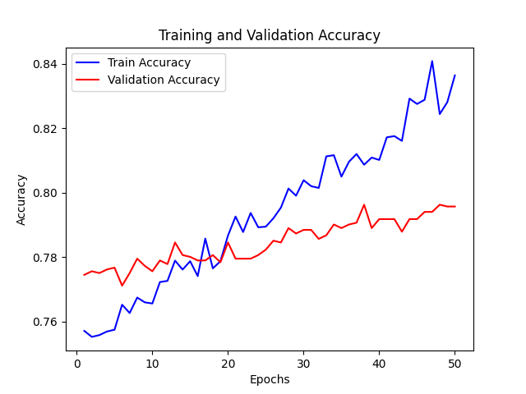
Ranking model using transfer learning with the model from Streetview

Slide 10
Data augmentation with random contrast Mapillary

Slide 11
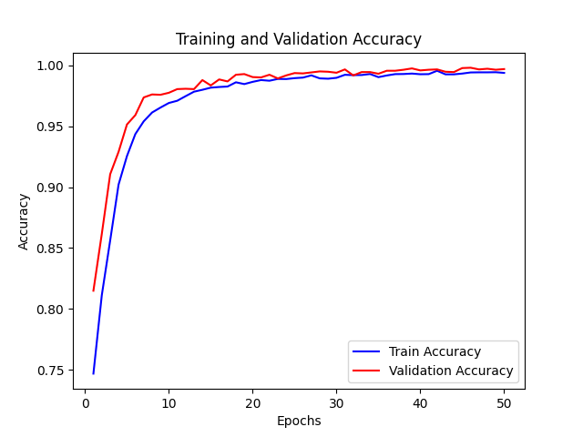
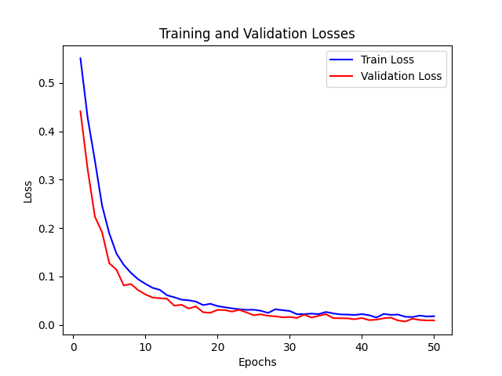
Ranking model trained on Mapillary data with data augmentation contrast

Slide 12
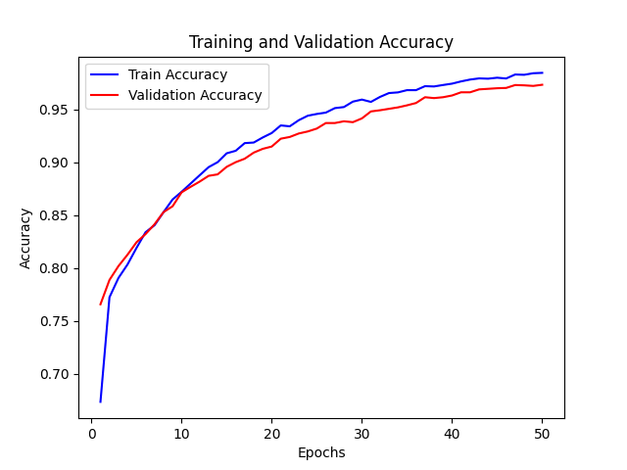
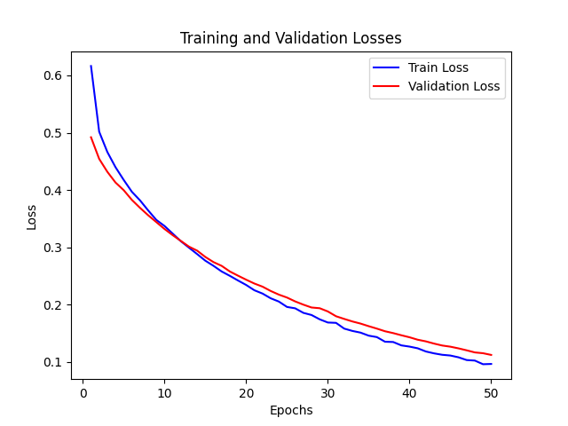
Comparison model trained on Mapillary data with data augmentation contrast

Slide 13
Data augmentation with random contrast Streetview

Slide 14
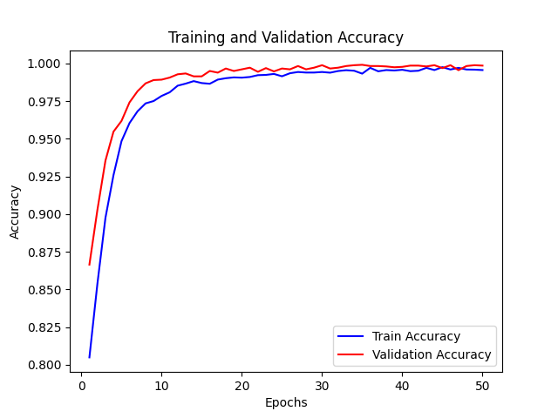
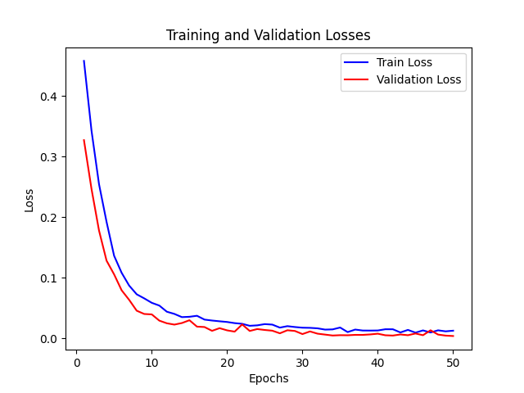
Ranking model trained on Streetview data with data augmentation contrast

Slide 15
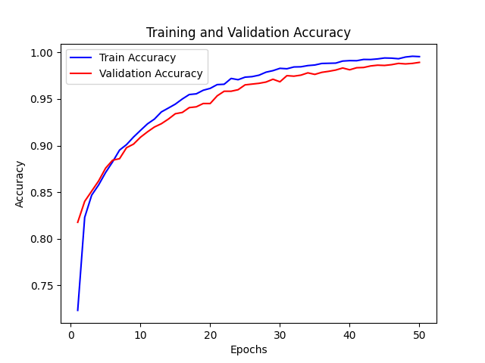
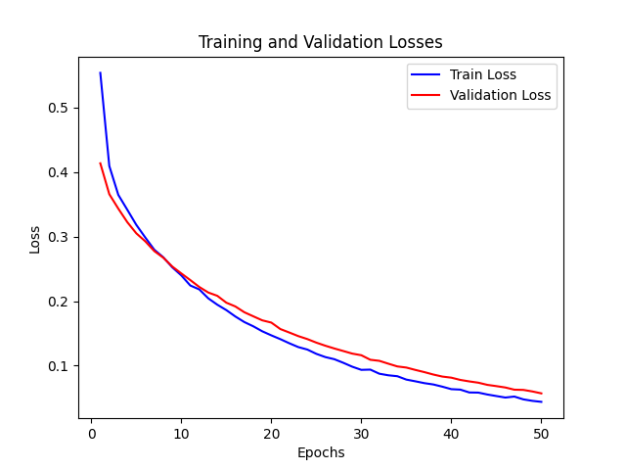
Comparison model trained on Streetview data with data augmentation contrast

Slide 16
Accuracy results

Slide 17
Comparison model with data augmentation including contrast
Model/Data | Streetview data | Mapillary data
Comparison model trained on mapillary data | 89% | 98%
Comparison model trained on streetview data | 99% | 83%

Slide 18
Ranking model with data augmentation including contrast
Model/Data | Streetview data | Mapillary data
Ranking model trained on mapillary data | 90% | 99%
Ranking model trained on streetview data | 100% | 85%

Slide 19
Generating heat maps

Slide 20
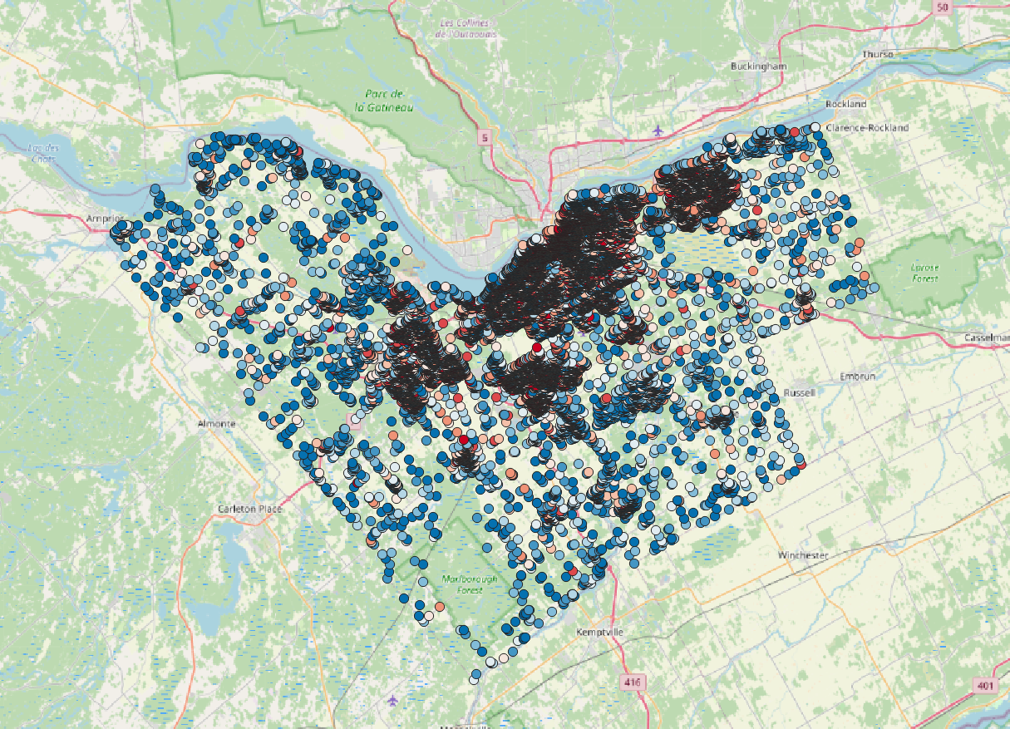
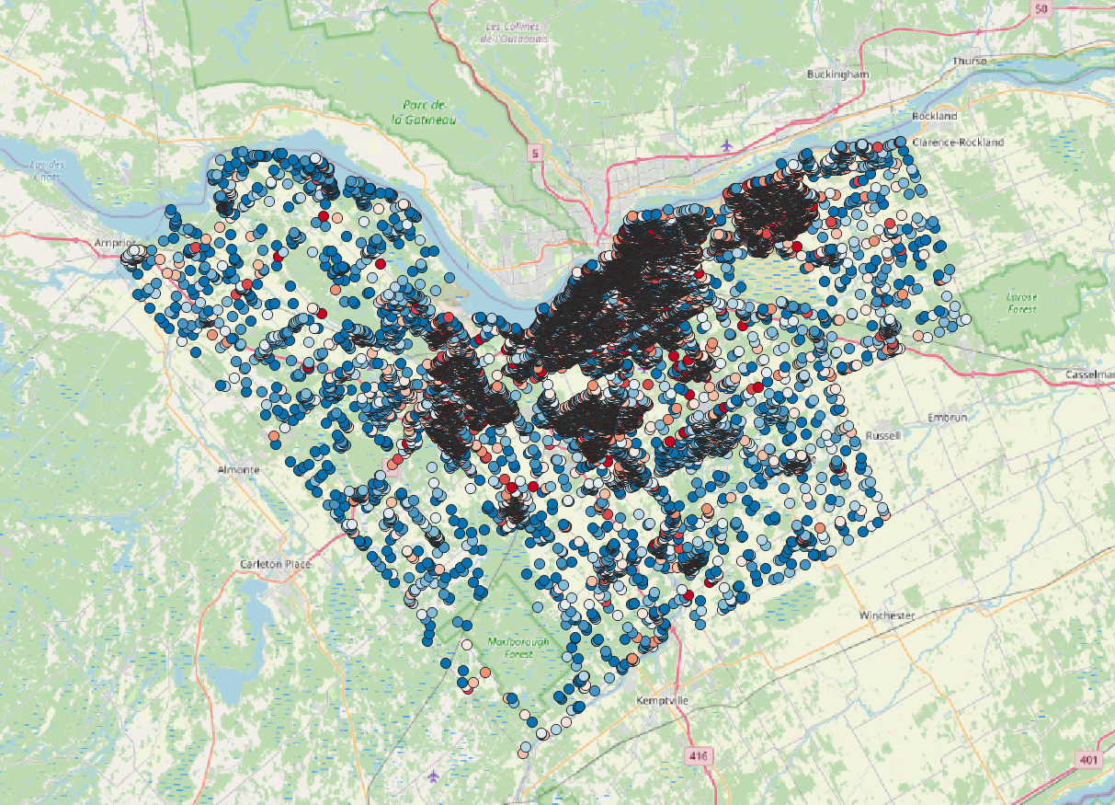
Heatmap for both ranking models
Streetview model points
Mapillary model points

Slide 21
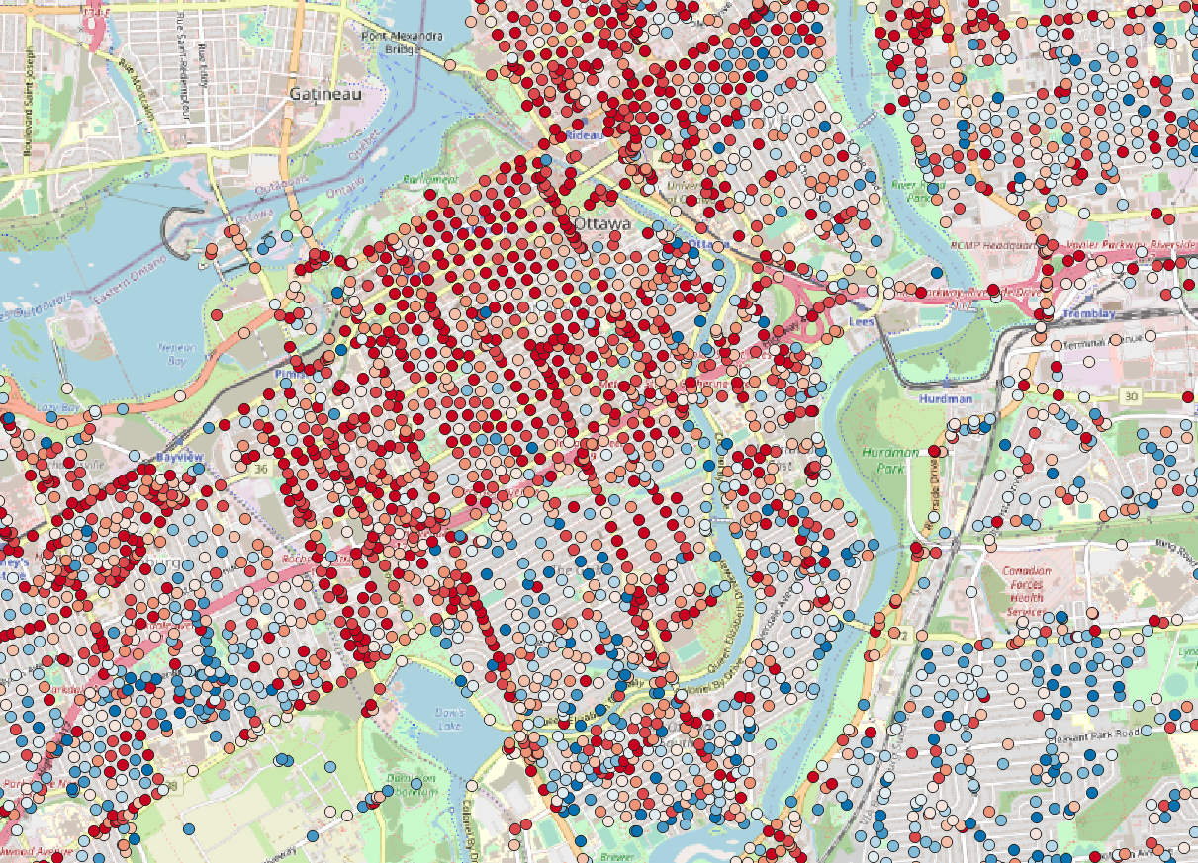
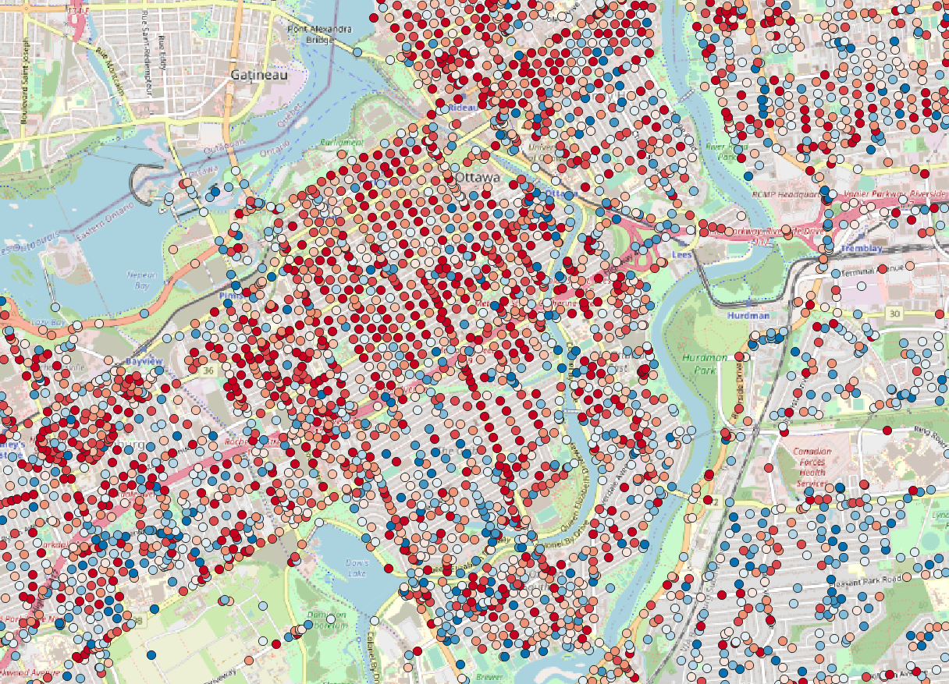
Heatmap for both ranking models
Streetview model points
Mapillary model points

Slide 22
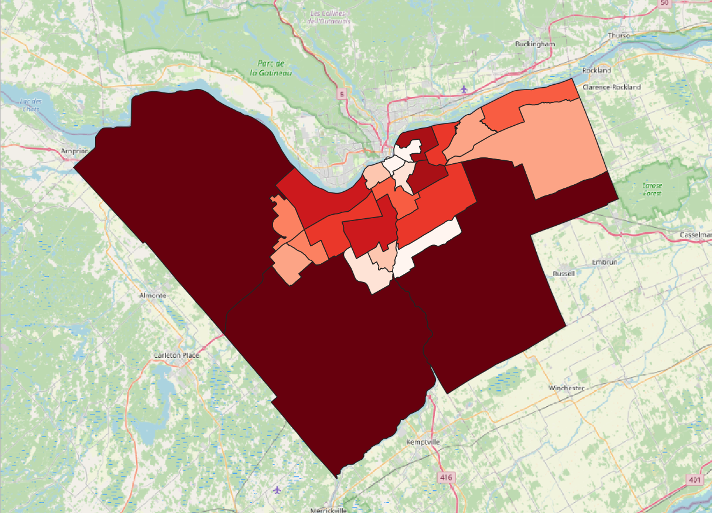
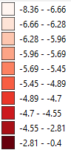
Mapillary heatmap

Slide 23
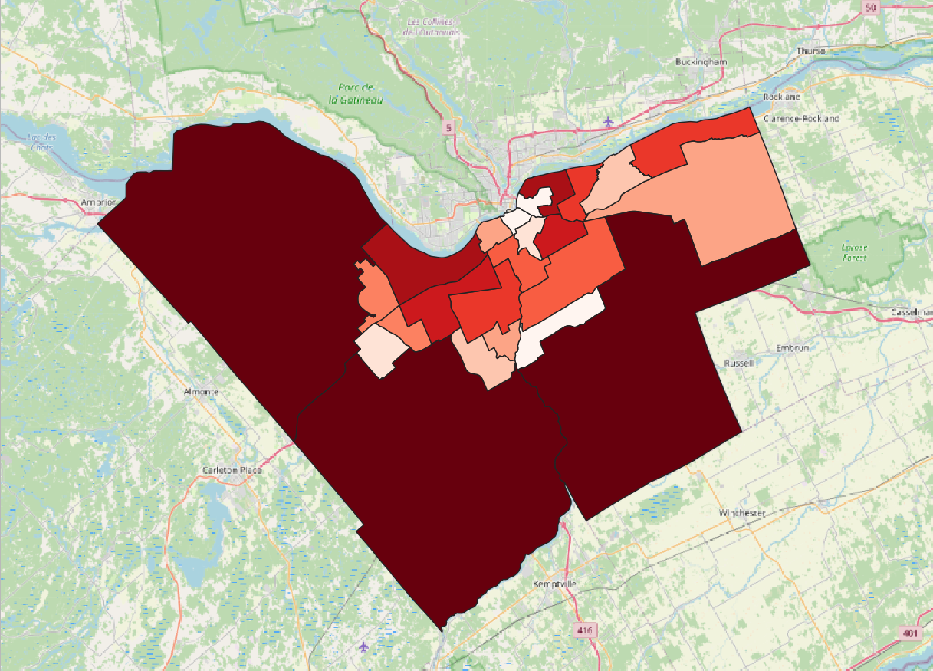
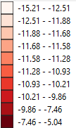
Streetview heatmap

